Slide 1


Department of Information Technology V R Siddhartha Engineering College
SMART ASSISTIVE SYSTEM FOR REAL-TIME AV INTERACTION AND HOME AUTOMATION USING RASPBERRY PI AND ARDUINO
B.Tech in Information Technology
Project Review Presentation
Presented by
R.Harathi (228w5a1207)
S.Sashank Sai (218w1a1256)
Under the guidance of
Dr.Ch.SubbaReddy, Assistant Professor

Slide 2
Problem Statement
Our project integrates smart home automation with enhanced remote communication, addressing the need for efficient interaction at the doorstep and convenient appliance control. Smart home automation enables remote monitoring and management of devices like lighting and security systems through internet-connected devices. This system uses technologies such as WiFi and IoT to ensure reliability and cost-effectiveness. By combining automation with real-time communication features, users can receive notifications and interact with visitors remotely, reducing missed deliveries and misunderstandings. This comprehensive system aims to bridge affordability and functionality, making smart home technology more accessible and interactive for diverse user needs. It enhances security, comfort, and energy efficiency while providing a seamless user experience.

Slide 3
Objectives
Develop a Remote Communication System
Implement Audio and Video Monitoring
Future Integration with a User Friendly Minimal App Interface
Develop a wifi-based home automation system using arduino and a wifi module to control appliances within a localized network.

Slide 4
Outcomes
Remote Video and audio access
Integration of text-to-speech technology
wifi-based smart home automation system
Remote access of the appliances
Compatibility and user-friendliness

Slide 5
LITERATURE REVIEW
Tile of paper | Author | Published date | Summary
Automated Surveillance System using Raspberry pi | Pallavi Mhaiskar Vaishnavi Lanjewar | 10-11 November 2022 | AI technology enables a Raspberry Pi-based Internet monitoring system to overcome traditional surveillance system limitations. The system uses a PIR sensor and image processing for real-time object tracking, enhancing crime prevention and security.
Surveillance Camera using IoT and Raspberry Pi | Bandi Narasimha Rao; Reddy Sudheer | 5-17 July 2020 | This paper presents a low-cost system based on Raspberry Pi, with a Motion Detection algorithm in Python. This reduces storage use and costs. The system allows live streaming of video with motion detection, accessible on any web browser or mobile device..
SMART VIDEO DOOR BELL DEVICE WITH TWO WAY AUDIO USING RASPBERRY PI | Suvarna Rohile, Amisha Rokade, | 11 November 2021 | The paper suggests an IoT doorbell system with security features using Raspberry Pi. It enables remote visitor viewing, image capture, two-way communication via Gmail, and uses MAC encryption for security, aiming for a secure and convenient doorbell solution.
Low cost real-time system monitoring using Raspberry Pi | Quoc Nguyen Huu | 7-10 July 2015 | A cost-effective surveillance system using Raspberry Pi and motion detection is proposed to improve on traditional CCTV systems. Storage costs are reduced by a Python motion detection algorithm. Accessible via web browsers.
Development of Android Based Mobile Video Conference Application Using Jitsi Meet Platform | Emre Dandil | June 2021 | An Android app organizes communication tasks such as meetings, calls, and messaging using Jitsi Meet for seamless video conferencing.

Slide 6
LITERATURE REVIEW
Tile of paper | Author | Published date | Summary
IoT based Secure Smart Home Automation System | 11-13 February 2022 | A.P. Nirmala, V. Asha, Paramita Chandra. | The paper presents an IoT-based smart home automation system using Arduino and WiFi module, integrating sensors (MQ2, TMP36, IR) for safety and monitoring. It enables remote control via mobile app and voice commands, with real-time cloud synchronization. However, it faces limitations like scalability issues, basic security, and WiFi dependency.
IoT based enabling home automation system for individuals with diverse disabilities | December 2023 | P. Anuradha, K. Vasanth G. Renuka | The paper proposes an IoT-based home automation system designed to assist individuals with disabilities, using sensors and IoT modules for accessibility. It focuses on voice control, remote monitoring, and customizable interfaces to cater to diverse needs. However, it faces challenges like complex setup, cost constraints, and dependency on stable internet connectivity
Smart home automation system using Arduino microcontrollers | 01 July 2020 | D. -I. Gota, A. Puscasiu | The paper presents an IoT-based smart home system using Arduino and WiFi modules for appliance automation and remote monitoring. It integrates sensors for environmental control and emphasizes user-friendly interfaces like mobile apps and voice commands. However, it faces limitations such as limited scalability, basic security measures, and reliance on stable WiFi connectivity.

Slide 7
Requirements
Core Components :
1. Raspberry Pi 4:
Main controller running RealVNC Server for remote GUI access via RealVNC Viewer
2. Pi Camera Module:
Captures HD video feed for visitor identification
3. USB Microphone:
Records audio input for two-way communication
4. Arduino Uno:
Manages 5V relay module for door/gate control via GPIO signals
5. Doorbell Switch:
Manual activation input connected to Pi's GPIO
6. 4-Channel Relay Module:
Modified with trimmer resistors (10K-100KΩ) for 3.3V compatibility with Pi/Arduino
7. ESP8266 WiFi Module:
Enables IoT connectivity for Arduino-to-Pi data transmission

Slide 8
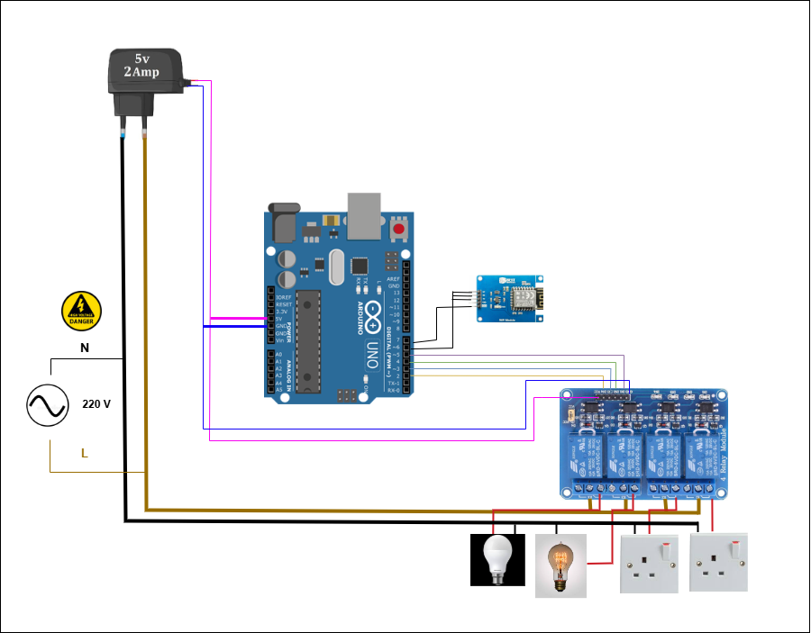
Architecture Diagram

Slide 9
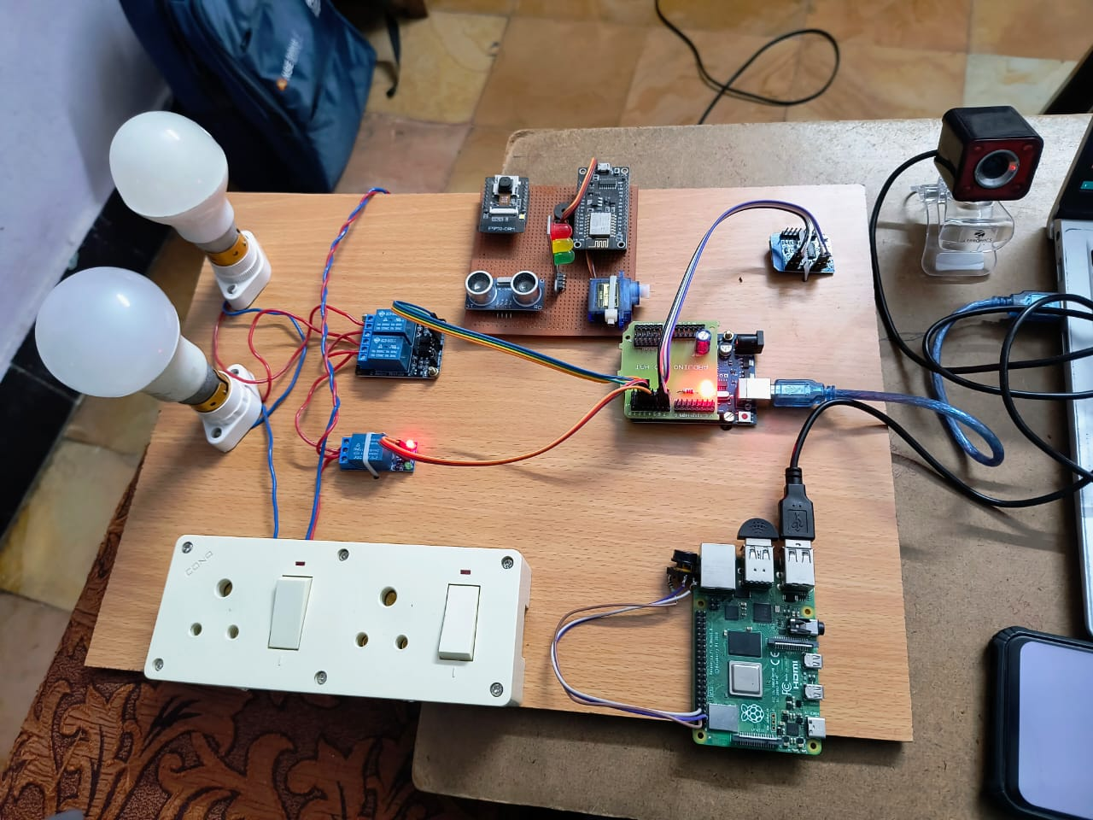
SYSTEM CONNECTIONS

Slide 10
SYSTEM CONNECTIONS
1. Power Supply (5V, 2Amp): Positive (+): Connected to the Vin pin of the Arduino and the VCC pin of the relay module. This provides the necessary power to both the Arduino and the relays. Negative (-): Connected to the GND pin of the Arduino and the GND pin of the relay module. This provides a common ground for the circuit. 2. Arduino UNO to WiFi Module: VCC (WiFi Module): Connected to the 3.3V pin of the Arduino. The WiFi module typically operates at 3.3V. GND (WiFi Module): Connected to the GND pin of the Arduino. TX (WiFi Module): Connected to the RX (Pin 0) pin of the Arduino. This is for transmitting data from the WiFi module to the Arduino. RX (WiFi Module): Connected to the TX (Pin 1) pin of the Arduino. This is for receiving data from the Arduino to the WiFi module. 3. Arduino UNO to Relay Module: Digital Pins (Arduino): Connected to the IN1, IN2, IN3, and IN4 pins of the relay module. These pins send control signals to the relays.

Slide 11
SYSTEM CONNECTIONS
4. Relay Module to Appliances (Bulbs and Sockets): COM (Common) Terminals of Relays: Connected to the Live (L) wire from the 220V AC power source. NO (Normally Open) Terminals of Relays: Connected to one terminal of each bulb and one terminal of each socket. Neutral (N) Wire: Connected directly to the other terminal of each bulb and socket. 5. 220V AC Power Source: Live (L) Wire: Connected to the common (COM) terminals of the relays. Neutral (N) Wire: Connected directly to the bulbs and sockets.

Slide 12
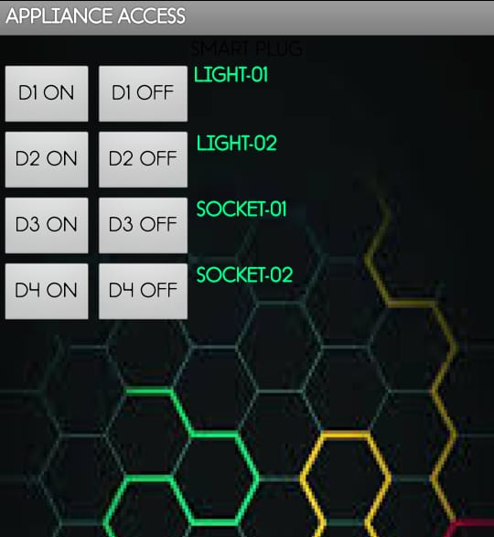
APP INTERFACE
The app interface is simple and user-friendly, displaying a table with four rows, each representing a different appliance or device that can be controlled remotely. The columns indicate the status of each device (ON) setup suggests that the app allows users to control lights and sockets remotely, likely through a connected IoT system. The "ON" status indicates that the devices are currently active. The app is part of a smart home or automation system, enabling users to manage their appliances from a mobile device.

Slide 13
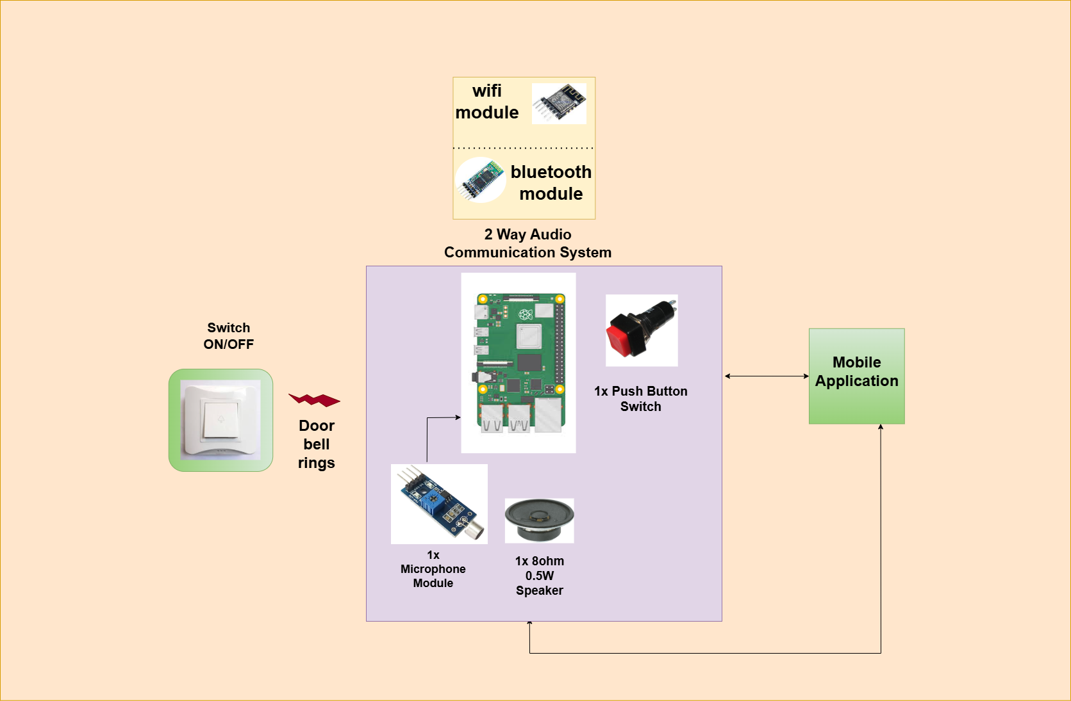
Architecture Diagram

Slide 14
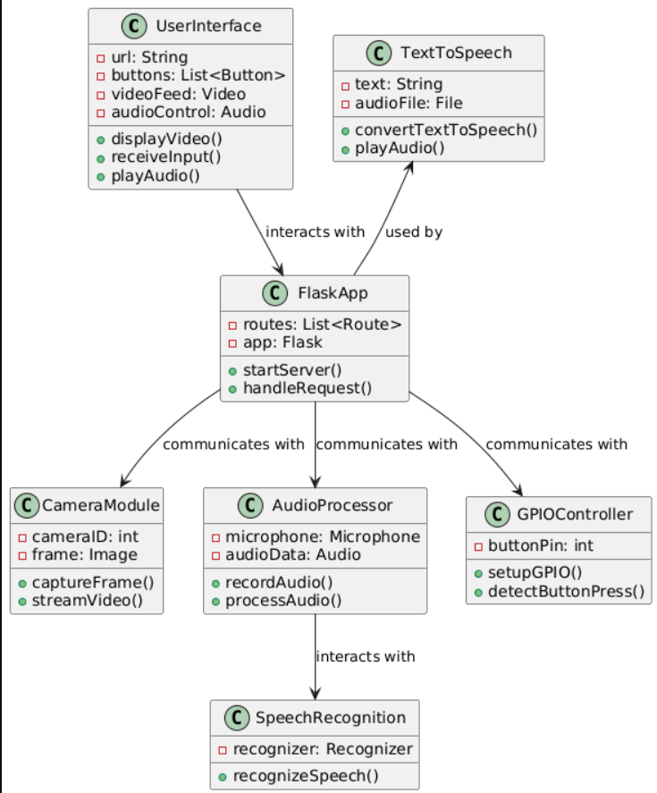
UML REPRESENTATION

Slide 15
Audio Communication with Raspberry pi
Button Press Detection:
The Raspberry Pi 4 is configured to monitor four distinct button presses, utilizing the GPIO pins. Each button press triggers a specific function within a Python script, allowing for seamless interaction and control over the system's operations.
Communication System Activation:
Upon detecting four consecutive button presses, the script initiates a two-way communication system. This is facilitated through a web browser interface, enabling users to engage in real-time video and audio conversations.
Notification System Integration:
Concurrently, the system is designed to send notifications via email upon the activation of the communication link. This ensures that all relevant parties are informed and can join the conversation promptly.
Video Conferencing Launch:
Once participants click the provided link or a designated button within an application, the system automatically launches a video conferencing session. This allows for effective visual and auditory communication, enhancing user interaction during meetings or discussions.

Slide 16
RESULTS
We successfully developed an interactive assistive system that combines video streaming, audio recording, and text-to-speech functionalities on a Raspberry Pi, enhancing accessibility for visually impaired users. This integrated solution provides real-time interaction and feedback within a local network environment, significantly improving user engagement and navigation.

Slide 17
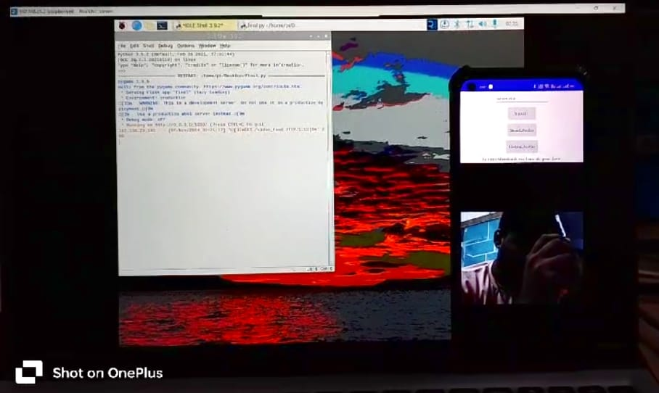
Video monitoring with webcam in localhost

Slide 18
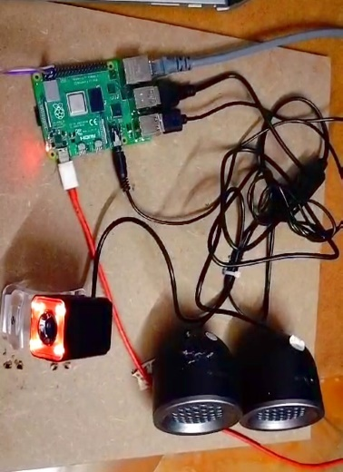
Raspberry pi 4 setup for the Video & Audio communication

Slide 19
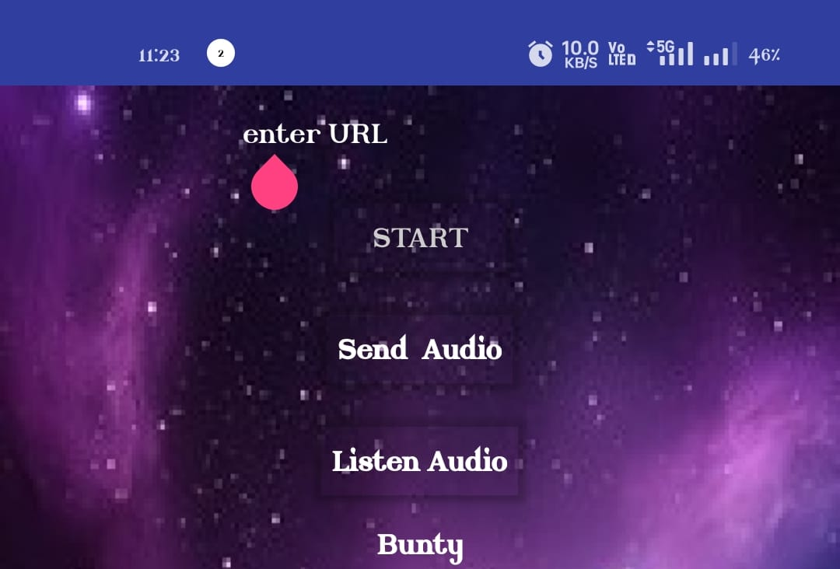
App interface for Video monitoring and Audio communication

Slide 20
Components
Pi camera | Arduino
Earpiece/Speaker | Relay Module
Raspberry Pi | Wifi module
microphone | Appliances

Slide 21
CONCLUSION
The proposed smart home system integrates advanced technologies like IoT, WiFi connectivity, and microcontrollers to create a seamless and efficient living environment. By combining visitor communication features with home automation, this system enhances security, convenience, and energy efficiency. It leverages devices such as Raspberry Pi and Arduino to manage appliances and interact with visitors remotely, ensuring timely communication and reducing missed deliveries. The system's modular design allows for scalability and adaptability, making it accessible to a wide range of users. As smart home technology continues to evolve, integrating AI and IoT will further enhance its capabilities, providing a holistic and intelligent living experience that anticipates and responds to user needs.

Slide 22
References
N. Bagal and S. Pandita, "Transmission of Audio Over Wireless Networks Using Raspberry Pi in Real-Time," International Journal of Innovative Research in Science, Engineering and Technology, vol. 4, no. 9, September 2015.
V. A. Vyavahare, "Live Audio and Video Transmission System Using Raspberry Pi," International Journal of Innovative Research in Computer and Communication Engineering, vol. 4, no. 6, June 2016.
J. Malliss, V. Patel, S. Yadav, H. Varun, and S. Patnaik, "Real Time Communication (RTC) Device using Raspberry Pi," International Journal of Scientific & Engineering Research (IJSER), 2022.
S. Sundar D.C.E et al., "Design and Analysis of Raspberry Pi Based Voice Communication System," International Journal of Advances in Engineering and Management (IJAEM), vol. 4, no. 6, June 2022.
A. S. M. Rahman et al., "Voice Control Device using Raspberry Pi," IEEE, 2020 International Conference on Electrical, Computer and Communication Engineering (ECCE), 15-17 January 2020.
S. M. A. Rahman et al., "Portable IP-based communication system using Raspberry Pi as a video and voice communication device," IEEE, 2018 International Conference on Electrical, Computer and Communication Engineering (ECCE), 19-21 February 2018.

Slide 23
References
A. P. Nirmala, V. Asha, P. Chandra, H. Priya, and S. Raj, "IoT based Secure Smart Home Automation System," IEEE (2022).
P. Anuradha, K. Vasanth, G. Renuka, and A. Rajeshwar Rao, "IoT based enabling home automation system for individuals with diverse disabilities," Scopus-indexed Journal (2023).
S. R. N. Reddy, P. N. Reddy, and K. S. Prasad, "IoT based Smart Home Automation System using Arduino and WiFi Module," IEEE (2020).
M. S. Khan, M. A. Siddiqui, and M. A. Khan, "IoT based Smart Home Automation System using Arduino and NodeMCU," IEEE (2018).
A. Kumar, S. Gupta, and R. Kumar, "IoT based Home Automation System using Arduino and WiFi Module," IEEE (2017).
S. R. N. Reddy, P. N. Reddy, and K. S. Prasad, "IoT based Smart Home Automation System using Arduino and WiFi Module," IEEE (2020).
M. S. Khan, M. A. Siddiqui, and M. A. Khan, "IoT based Smart Home Automation System using Arduino and NodeMCU," IEEE (2018).
A. Kumar, S. Gupta, and R. Kumar, "IoT based Home Automation System using Arduino and WiFi Module," IEEE (2017).

